Slide 1
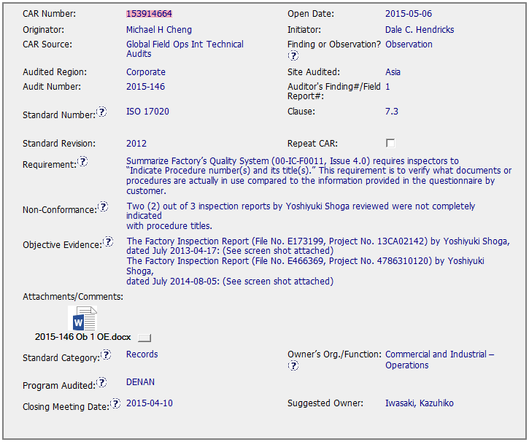
CAR 153914664
clause 7.3 of ISO 17020 should have been stated
It would be better reference to the employee number instead of the name.

Slide 2
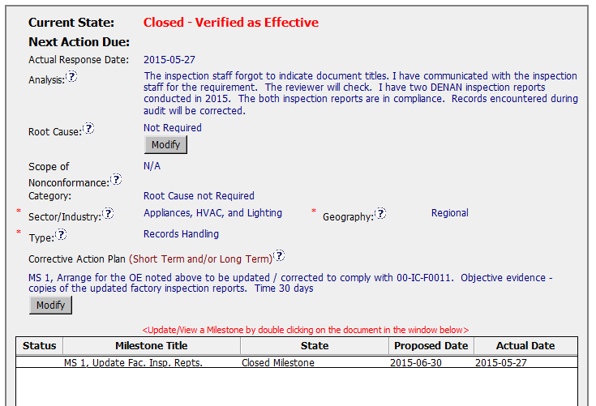
CAR 153914664
As this is an Observation Analysis, Root Cause and Scope of Non conformance should be N.A., but in this case the Owner just included an explanation.
No evidence of communication with the inspection staff
Open discussion topic: If they want to apply this CAR to an entire region … they needed to at least show that they did ‘Refresher training’ for the entire region and then should have added a Verification milestone and sampled some records from the entire region.

Slide 3
CAR 153914664 - CBS
INTEGRITY: Initiative & Decision Making / Analyzing & Problem Solving
Facilitates progression of the CAR through closure: extensions, escalations, reassignments, etc. (+)
Accurately completes the administrative fields within the CAR such as root cause category, process impacted, geography, etc. (-)
Acts on CARs within the required timeframe (+)
Most appropriate ‘category’, ‘type’, ‘geography’ are selected (-)

Slide 4
CAR 153914664 - CBS
COMPETIVENESS: Customer Focus / Achieve Business Results / Flexibility
Assists customers as they address all aspects of the CAR – analysis, root cause statement, milestone, containment, verification, etc. (+)
Verifies CARs timely (+)
Corrective actions fix the objective evidence and other problems found; address entire root cause and scope. (+)
Milestones address; completed per milestone expectations (+)
Verification per requirements (+)
COLLABORATION: Leading & Engaging / Teamwork / Communication
Provides pertinent feedback at appropriate times; shares information and keeps others informed (+)

